Slide 1

™
MARKETING PORTFOLIO 2026
BRAND, BEHAVIOR, AND CREATIVE
Work that has to change what people do.
Alvarys Santana, MBA · President & Principal Consultant
WOSB · WBENC · DBE · NC SBE
Notes:
The marketing-only cut. Three parts: identity, behavioral diagnosis, and the creative itself. Roughly twenty minutes.

Slide 2
ABOUT US
Strategy, research, results.
We're in the middle of creating our story, and you're already part of it.
What we do goes beyond marketing and communications. We help people and organizations find their voice, shape their message, and make real impact across industries. Together, we can build something new and meaningful, one story at a time.
CHARLOTTE, NC · FOUNDED 2021
™
Notes:
Their own words. Read it, do not paraphrase.

Slide 3
THE PRINCIPAL
Alvarys Santana, MBA
Award-winning grant and procurement writing specialist. Bilingual communicator with cultural fluency in Latinx communities and equity-centered storytelling. Founder of AS STRATEGY, serving clients including UNESCO, government agencies, and community-based nonprofits.
EDUCATION
CERTIFICATIONS
SECTORS
LANGUAGES
MBA, Fayetteville State University BA Political Science, Hunter College
Scrum Master Certified Strategic Leadership, Dartmouth DEI Foundations, Parsons
Arts, culture & heritage Housing & homelessness Mental health & substance use Maternal health equity
English Spanish
$17M+ SECURED SINCE 2021
389 APPLICATIONS SUBMITTED
28 LONG-TERM PARTNERSHIPS
Notes:
Bilingual, equity-centered, MBA. Clients from UNESCO to neighborhood nonprofits.

Slide 4
CONTENTS
Three parts
A brand nobody recognises cannot create awareness, and awareness that ignores the real barrier does not change behavior. The order matters.
01
Giving it a face
Marks, palettes, brand boards, and the guidelines that hold
02
Knowing why people don’t act
COM-B, EAST, and audience architecture applied to real barriers
03
The work in the world
Campaign creative, event collateral, and political field material
MARKETING & COMMUNICATIONS ONLY
Notes:
Three parts. Identity first, because nothing downstream works without it.

Slide 5
PART ONE
01
Giving it a face
An organisation that cannot be recognised cannot be referred to, funded, or trusted. The first job is always a face.
WYCCTH
NC LATINO MUSEUM
MARCRAW ALLIANCE
PESTZZS
TRECIG
Notes:
Part one is identity. Seven identities, nonprofit to commercial to government to cultural.

Slide 6
APPROACH
Every identity answers three questions
THE MARK
THE PALETTE
THE TYPOGRAPHY
What does it mean?
What does it feel like?
How does it speak?
A logo that symbolizes open doors and new beginnings, reflecting the safe, supportive path toward healing and independence.
Warm tones that are resilient yet vivid, evoking a sense of strength, renewal, and compassionate support.
Structure and softness, pairing bold clarity with handwritten warmth to reflect both resilience and humanity.
Notes:
Three questions every identity has to answer. Verbatim from the WYCCTH guidelines.

Slide 7

CASE STUDY · VISUAL IDENTITY
When You Can't Cope There's Hope
A complete brand identity and visual guideline for a transitional housing program supporting women recovering from substance use. The work defined a mission-driven aesthetic, a therapeutic colour palette, typography standards, and a cohesive system conveying trust, dignity, and hope across print and digital.
DELIVERABLES
Primary mark, lettermark, brand board, print and digital system
GEOGRAPHY
Richland County · Columbia, South Carolina
ALSO DELIVERED
Strategic plan 2025–2029, behavioral marketing plan, funder presentation
Notes:
Transitional housing for women in recovery. The mark had to read as safety, not institution.

Slide 8
CASE STUDY · VISUAL IDENTITY
NC Latino Museum of History and Culture
LOGO · PALETTE TYPOGRAPHY · GUIDELINES
The logo represents the Latino community, infused with African roots and Native American influences. Its vibrant colors reflect unity, while the triangle beside the word "culture" emphasizes the elements of persuasion.
FONTS
COLORS
PRIMARY
Cinzel Decorative
SECONDARY
Montserrat
#497544
#286073
#D87029
#E49924
#C12451
Rainforest Green
Ocean Indigo
Sun Clay Orange
Heritage Gold
Cultural Red
BONUS, FOR STORYTELLING
Merienda
Notes:
Palette and typography verbatim from the delivered guidelines.

Slide 9
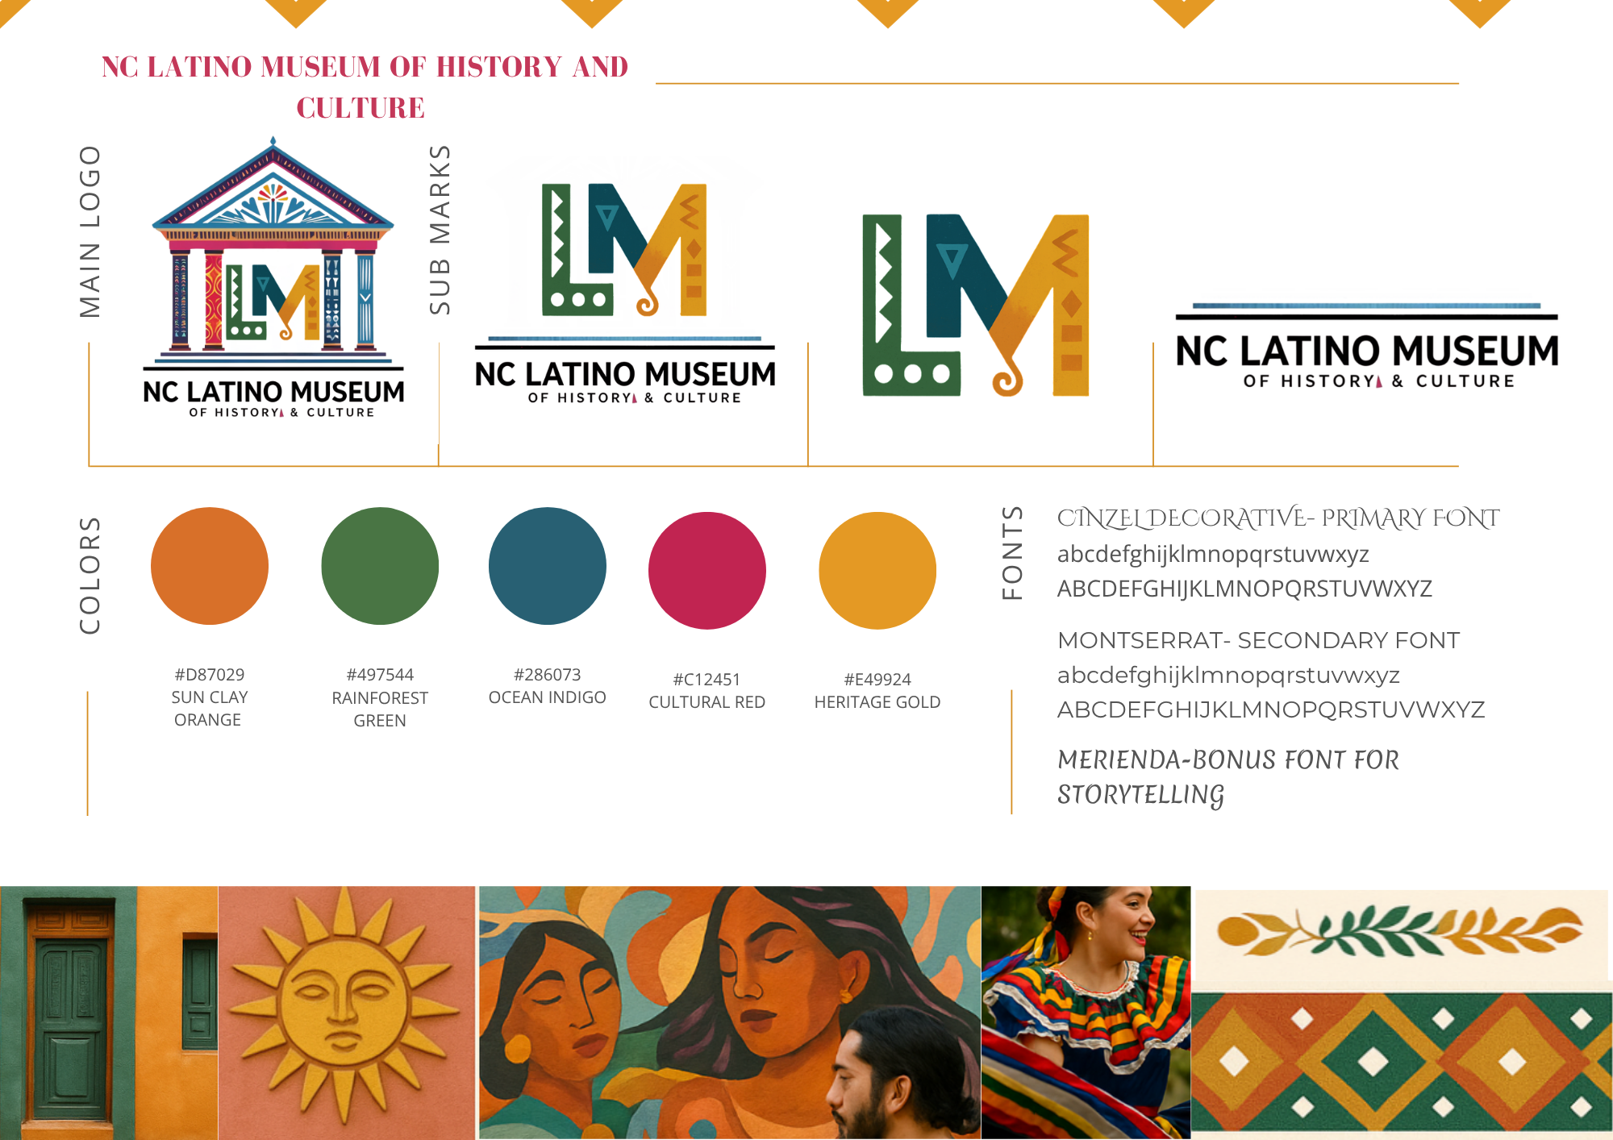
NC LATINO MUSEUM · BRAND BOARD
Logo family, palette with named hexes, three-font hierarchy, and an imagery direction the museum can brief a photographer from.
The full system, as delivered
Notes:
The delivered brand board: main logo, three sub marks, five-colour palette, three-font system, and imagery direction.

Slide 10
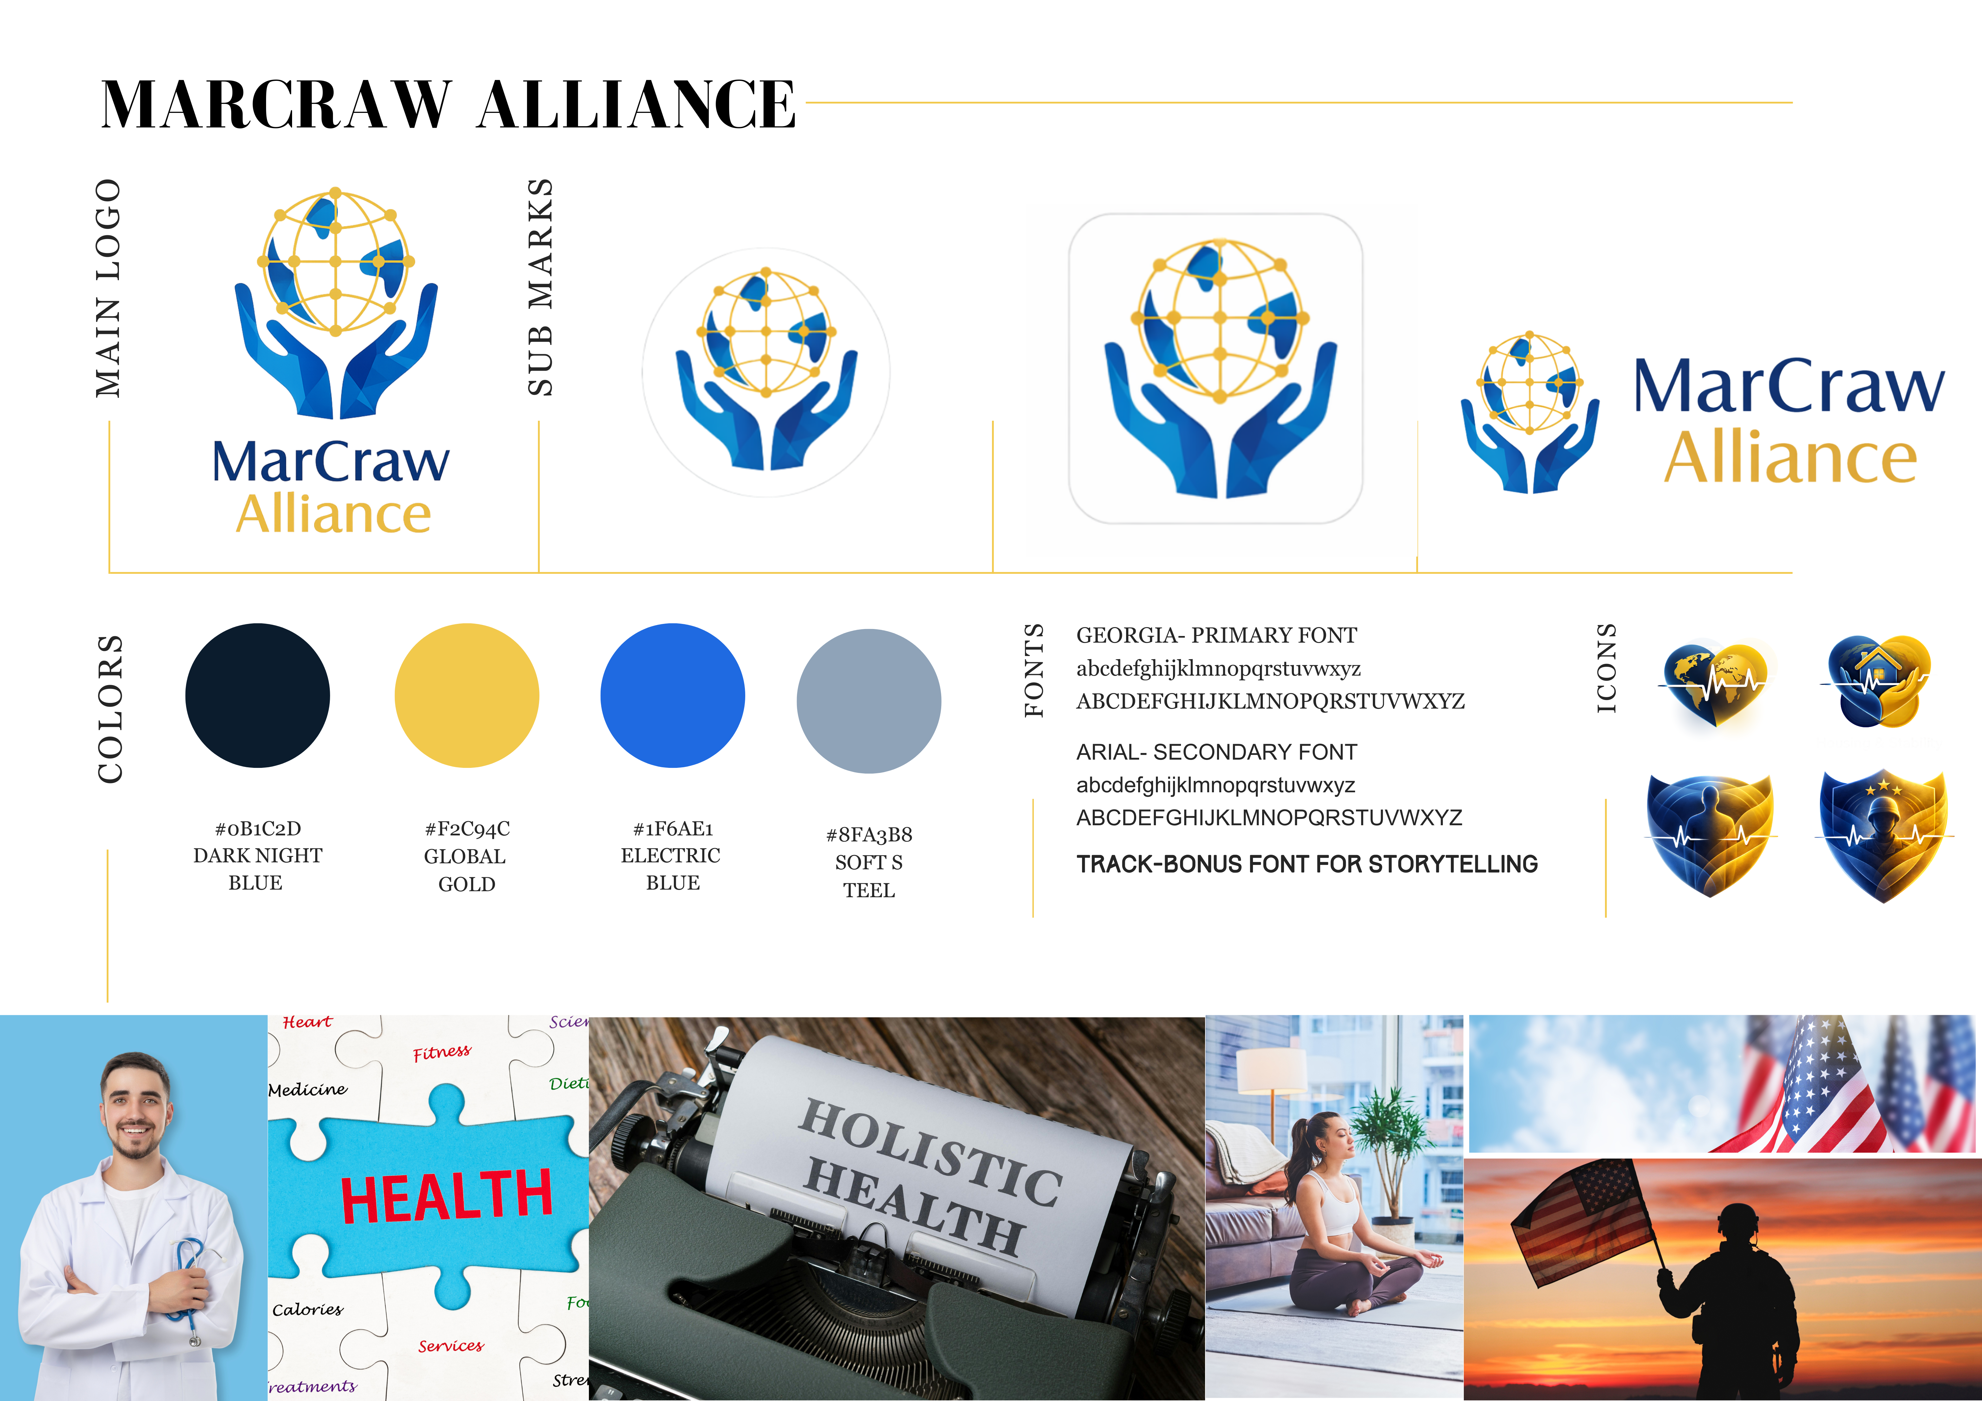
Wraparound health services for veterans and families. Delivered alongside bylaws, policy suite, capability statement, and a 2026–2028 strategic plan.
CASE STUDY · BRAND BOARD
MarCraw Alliance
Notes:
A full brand board as delivered: main logo, sub marks, palette, fonts, icon set, imagery direction.

Slide 11




Commercial and government pest control, South Carolina. Wordmark, monogram family, uniform patch, foundation endorsement lockup, brand guidelines, and a WordPress theme.
CASE STUDY · BRAND SYSTEM
PestZZs
MAGENTA CIRCLE ICON
ROUNDED NEON BADGE
CYAN SQUARE ICON
UNIFORM PATCH
Notes:
A commercial brand, not a nonprofit one. Same rigour, different register.

Slide 12



PESTZZS · APPLIED
The system in use
Notes:
Applied: social cover, stacked lockup, and the foundation endorsement.

Slide 13
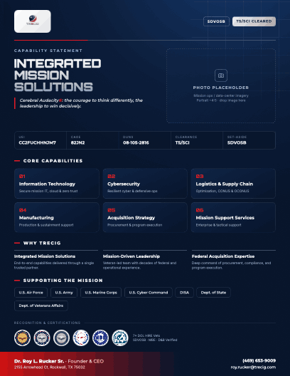
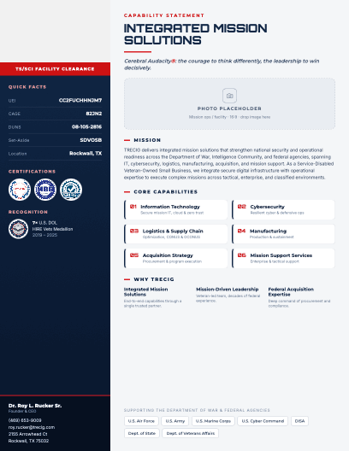
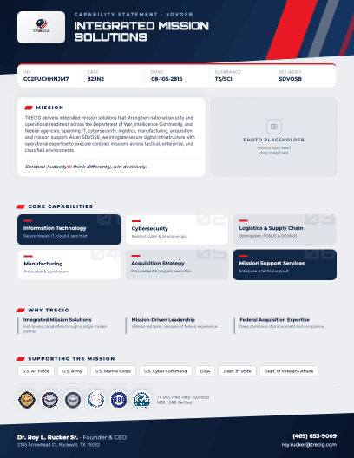
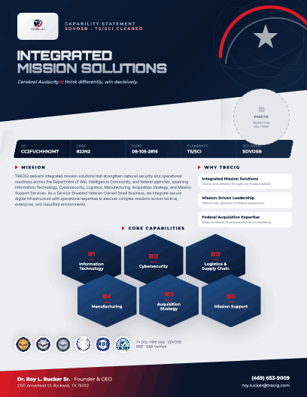
CASE STUDY · CONCEPT DEVELOPMENT
TRECIG: four routes, one decision
A veteran-owned cybersecurity contractor, SDVOSB and TS/SCI cleared. We presented four distinct territories rather than four versions of one idea, so the client chose a position, not a picture.
Route A
Route B
Route C
Route D
Command
Blueprint
Momentum
Vanguard
Authority and chain of custody. Military heritage worn openly.
Engineering precision. Systems drawn, not described. The route the client carried forward.
Forward motion and speed of response. Built for growth-stage bidding.
Front-line posture. Emblem-led, closest to the challenge-coin tradition.
Notes:
Four named routes presented to the client, not four variations of one.

Slide 14





PART ONE · CLOSE
Marks in the field
Nonprofit, commercial, government, and cultural clients. Same discipline, different register.
Notes:
Part one closes on the range: nonprofit, commercial, government, cultural.

Slide 15
PART TWO
Knowing why people don’t act
02
Awareness is not the barrier. Capability, opportunity, and motivation are. We diagnose which one is missing before we write a word.
COM-B
EAST
AUDIENCE ARCHITECTURE
Notes:
Part two is the diagnostic layer. This is the part most agencies skip.

Slide 16
STRATEGIC IMPLICATION
THE PREMISE
Our first audience is not the public. It is the twenty people in Richland County who decide where a woman sleeps tomorrow night.
Four models tell us where the friction sits
Behaviour change is diagnostic before it is creative. Every plan we write names the specific behaviour, the specific person, and the specific thing standing in the way, and only then decides what to make.
Public awareness is the second move. It exists to make those twenty people's decision socially obvious, and to make donors proud to be seen funding it.
Notes:
Read the strategic implication out loud. It reframes who the audience is.

Slide 17
MODEL 01 · COM-B
Diagnosing why the referral doesn't happen
Behavior requires Capability, Opportunity, and Motivation at once. Remove any one and the behavior stops, no matter how good the cause is.
Capability
Opportunity
Motivation
Do they know how?
Can they, right now?
Do they want to?
BARRIER
BARRIER
BARRIER
A discharge planner doesn't know our eligibility criteria, intake hours, or whether we take MAT clients.
Referrals happen at 4:45pm on a Friday. If no one answers and bed status is unknown, the woman goes elsewhere.
Sending a client to an unproven home is a professional risk. Nobody is blamed for using the home they already know.
INTERVENTION
INTERVENTION
INTERVENTION
One-page referral card and laminated eligibility sheet, hand-delivered to every discharge desk in the county.
Live bed-availability line on the website, a single referral number, and a four-hour response guarantee.
Certification badges, named board members, a 90-day outcome report, and a referral loop that closes back to the sender.
Notes:
Barrier and intervention, side by side. This is the diagnostic that makes creative accountable.

Slide 18
MODEL 02 · EAST
Every asset must be easy, attractive, social, timely
This is the quality gate. If a flyer, form, or email fails one of the four, it gets rewritten before it ships.
E
A
S
T
Easy
Attractive
Social
Timely
Reduce every step to the fewest possible clicks, fields, and decisions.
Draw attention with dignity, not despair. No mugshots, no before-and-afters.
Make the desired behavior visible and endorsed by people the audience trusts.
Arrive at the moment the decision is actually being made.
Discharge-day handoff
September Recovery Month
Year-end and Giving Tuesday
Post-court-date follow-up
Three-field referral form
One phone number, everywhere
Pre-filled donation amounts
Default to monthly giving
Real resident photography
The open-door mark
Named, specific outcomes
Donor recognition wall
Pastor and clinician endorsements
Fourteen partners refer here
Church-to-church challenge
Public partner logo wall
Notes:
This is the quality gate. If an asset fails one of the four, it gets rewritten before it ships.

Slide 19
AUDIENCE ARCHITECTURE
Five audiences, one behavior each
AUDIENCE
THE ONE BEHAVIOR
PRIMARY FRICTION
LEAD CHANNEL
Women seeking help, and the families calling for them
Call or text the intake line today
Shame; fear of being turned away; no idea we exist
Search and Instagram
Referral professionals: discharge planners, drug court, DSS, probation
Add us to the standing referral list
Professional risk; unknown capacity; habit
In person and email
Government and public agencies
Contract beds and include us in RFPs
Certification, compliance documentation, data reporting
Meetings and capability deck
Faith and civic community
Adopt the home, give, host, volunteer, vouch
No one has asked them, specifically, for something specific
Pulpit and events
Donors and funders
Give recurring; renew annually
Can't see outcomes; unsure the organization will still exist in three years
Email and one-to-one
Notes:
Five audiences, one behavior each. This table is the spine of the plan.

Slide 20
PART THREE
03
The work in the world
Posters read at arm’s length under stress. Flyers that fill a room. Door hangers read in four seconds on a porch. This is where the theory has to survive contact.
OPIOID PREVENTION
FENTANYL PREVENTION
HIV AWARENESS
EVENT COLLATERAL
POLITICAL FIELD
Notes:
Part three is the creative itself. Let the work carry these slides; talk less.

Slide 21
CASE STUDY · OPIOID PREVENTION
Two campaigns, two points in the curve
WESTSIDE OPIOID TASK FORCE · CHICAGO
PINKSTEM · YOUTH PREVENTION
Response, at the sharpest end
Prevention, before the first pill
Chicago's West Side has been heavily impacted by the opioid crisis, with a sharp increase in overdose deaths linked to illicit fentanyl, especially among Black and Latino residents aged 16 to 35. A coalition of community leaders, healthcare providers, and grassroots organizations launched a multi-level prevention campaign in response.
The rise in opioid misuse among adolescents, particularly involving prescription medications, has had devastating consequences for families. PinkSTEM, a nonprofit focused on youth development and STEM enrichment, addressed the crisis through culturally relevant, science-based prevention aimed at young people of color in under-resourced areas.
Notes:
Two opioid campaigns, two audiences: adults in crisis and adolescents before it starts.

Slide 22
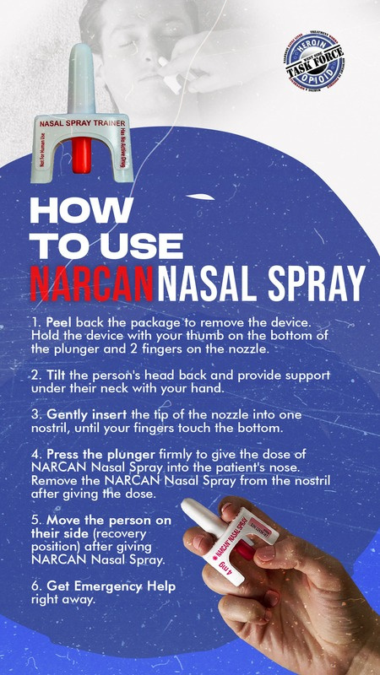
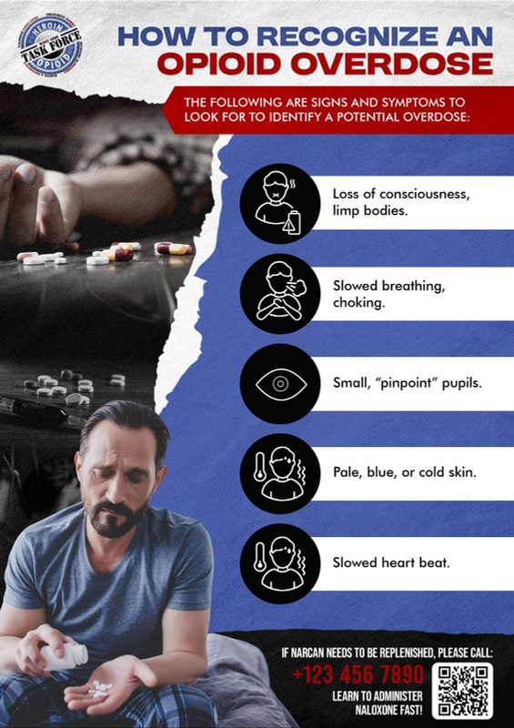


WESTSIDE OPIOID TASK FORCE · CREATIVE
Recognition, then response. Each asset is built to be read at arm's length, under stress, by someone who has never done this before.
Instructional creative for the overdose moment
RECOGNITION POSTER
RESPONSE POSTER
STORY FORMAT
SQUARE SOCIAL
Notes:
The Westside Opioid Task Force assets. Torn-paper edge, task force seal, black icon discs. Every piece answers one question a bystander has in the first sixty seconds.

Slide 23



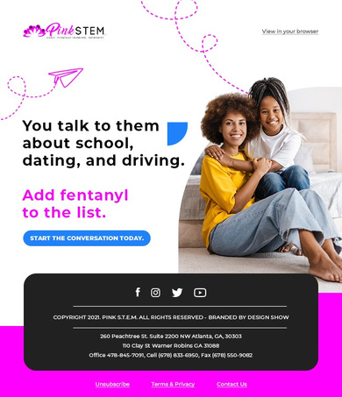
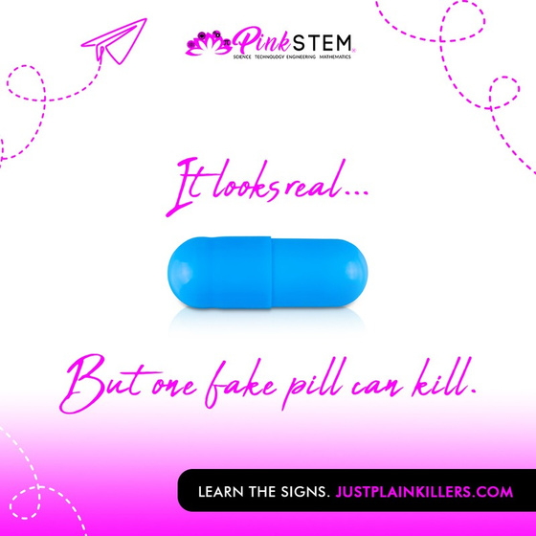
PINKSTEM · FENTANYL PREVENTION CREATIVE
The teen-facing work asks a question it knows the audience will get wrong. The parent-facing work turns an abstract fear into three things to do this week.
One system, two audiences: teens and the adults around them
TRICK QUESTION
PEER PRESSURE
PARENT ACTIONS
SQUARE SOCIAL
EMAIL
Notes:
PinkSTEM. The pill pieces are the behavioral core: a trick question that corrects a misperception instead of issuing a warning. Note the parent-facing and teen-facing halves of the same system.

Slide 24
CASE STUDY · PUBLIC HEALTH CAMPAIGN
HIV awareness and testing, Dominican Republic
KEY OBJECTIVES
01
Promote free and accessible HIV testing services for youth.
Designed to increase awareness, access to testing, and early intervention for HIV among youth, with a strong emphasis on community engagement and digital outreach. The campaign targeted individuals aged 15 to 34 and combined virtual education, in-person mobilization, and direct clinical services.
02
Increase awareness and reduce stigma through culturally tailored messaging.
03
Connect newly diagnosed individuals with treatment and support services.
MULTILINGUAL · YOUTH 15–34 · DIGITAL AND FIELD
Notes:
Dominican Republic, ages 15 to 34. Virtual education plus in-person mobilization plus direct clinical services.

Slide 25
HIV CAMPAIGN · FROM REACH TO DIAGNOSIS
What 125,000 impressions actually converted to
Every step down is a smaller number and a larger claim.
125,000+
Social media impressions
15,000+
Clicks through to the informational website
960
Engaged directly at community events and focus groups
580
Young people received HIV testing
36
Newly diagnosed, previously unaware
A 6.2% discovery rate · Dominican Republic · Ages 15–34 · Virtual education, in-person mobilization, direct clinical services
Notes:
The funnel is the argument. A hundred and twenty-five thousand impressions is a vanity number until it becomes thirty-six people who learned their status. Read the last line slowly.

Slide 26
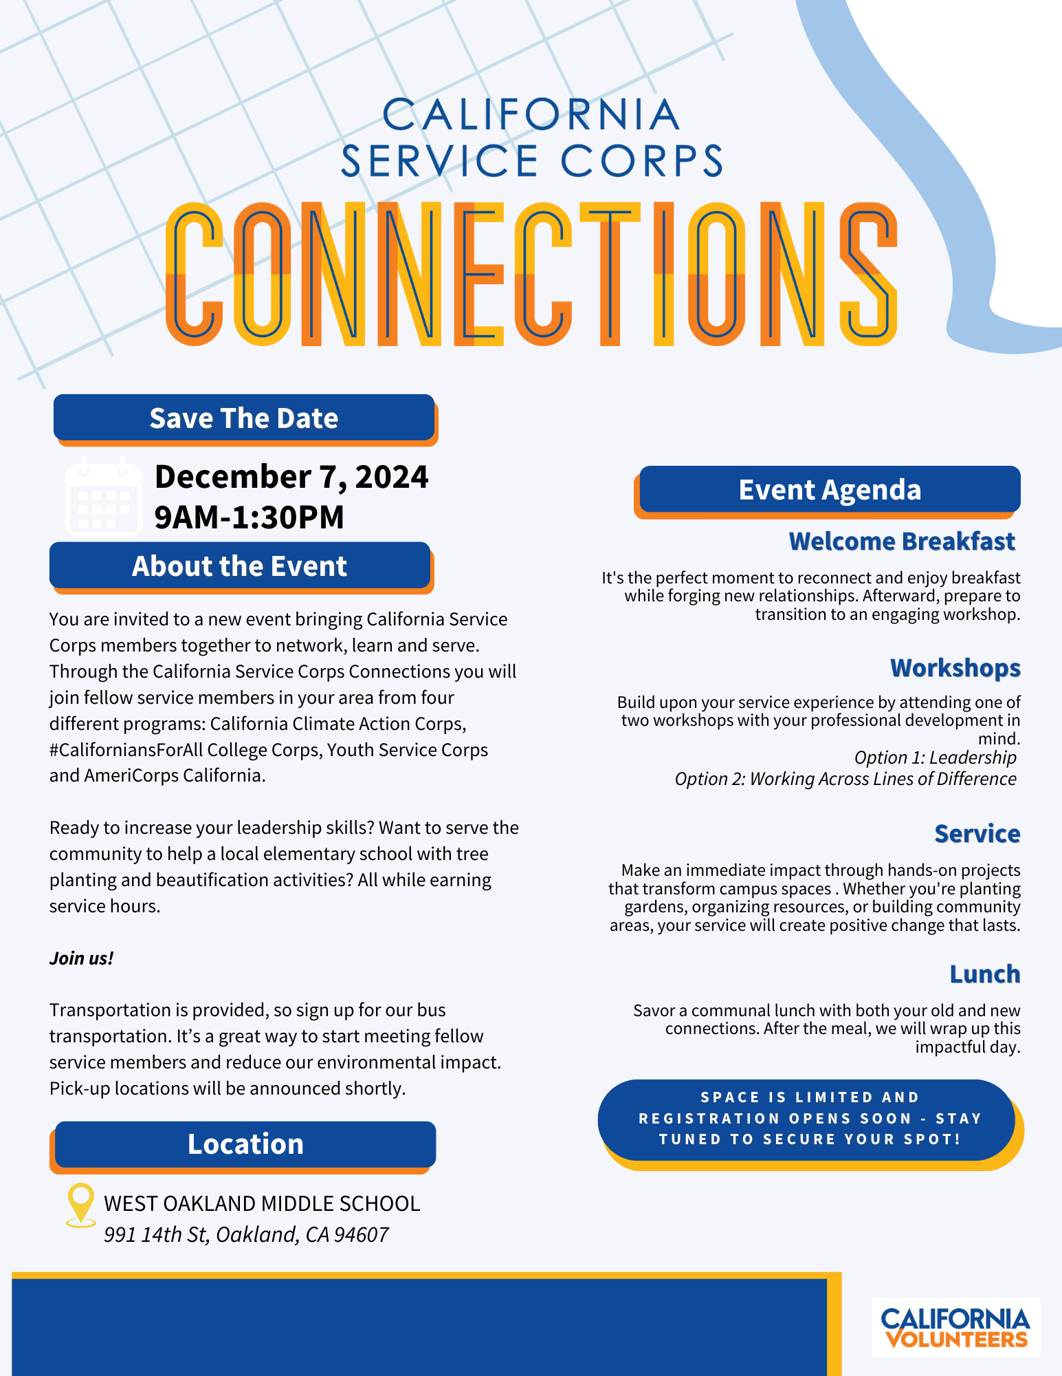


CALIFORNIA SERVICE CORPS · EVENT CREATIVE
Oakland, San Diego, Fresno, San Bernardino. The wordmark, agenda block, and partner lineup stay fixed; the photography and region change.
Four regions, one recognisable invitation
OAKLAND · DEC 2024
SAN DIEGO · FEB 2025
SAN BERNARDINO · MAY 2025
Notes:
Four regions, one event series, one visual system. Each flyer carries the same wordmark treatment, agenda block, and partner logo lineup so a member who saw Oakland recognises San Bernardino instantly.

Slide 27


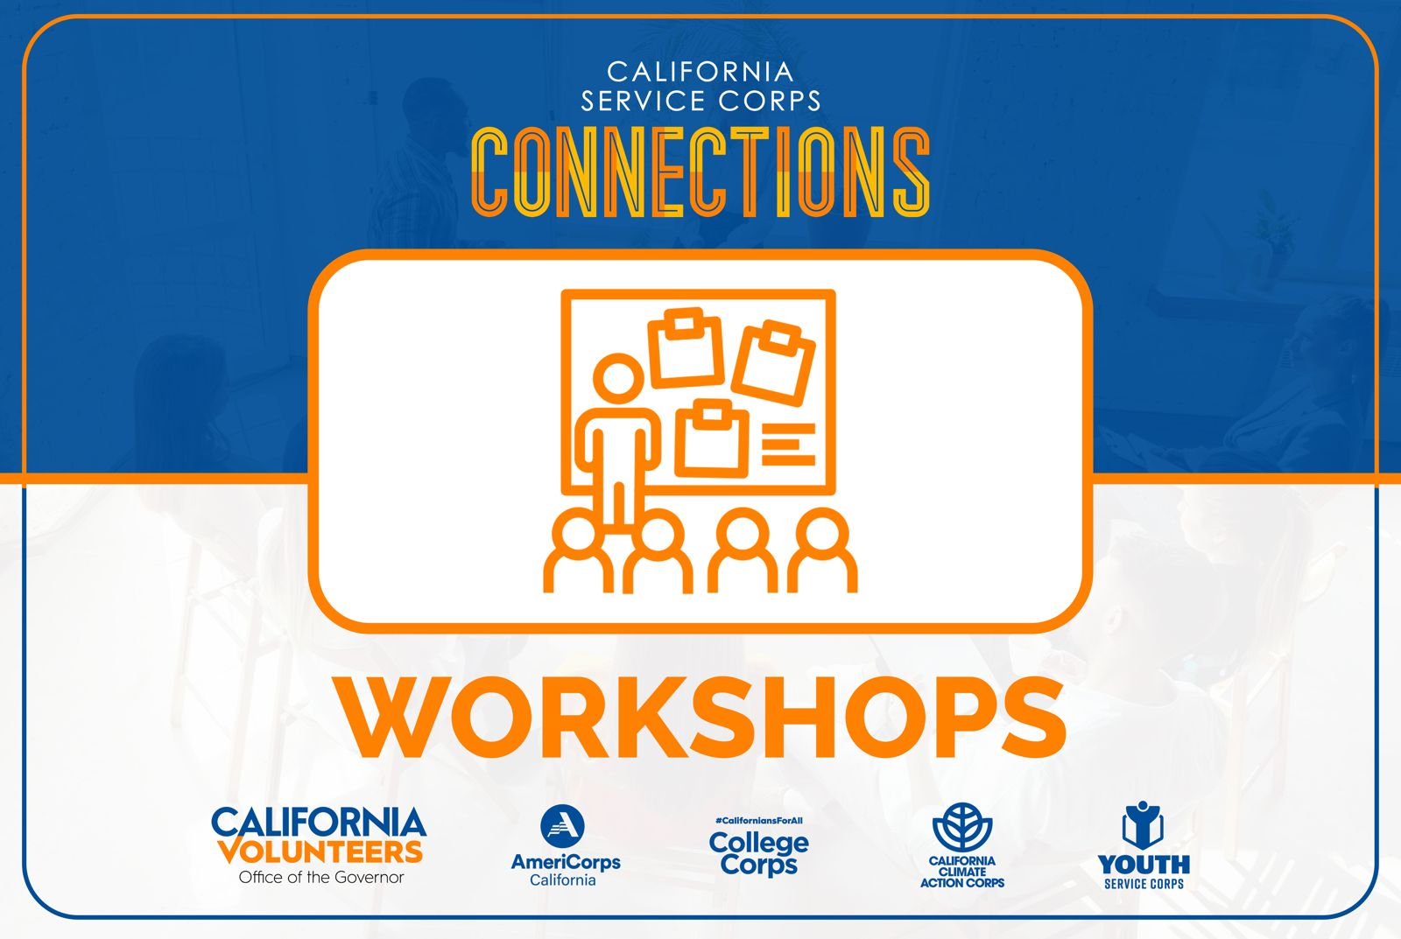

CALIFORNIA SERVICE CORPS · THE SYSTEM IN USE
Every surface a member touches
Four service programmes, one coalition. The system is what makes them read as one.
VIRTUAL FAIR BANNER
EMAIL HEADER
ON-SITE SIGNAGE
MERCHANDISE LINEUP
Notes:
The same identity across every surface a member touches on the day: email header, virtual fair banner, signage, and merchandise. Consistency here is what makes a four-programme coalition feel like one organisation.

Slide 28
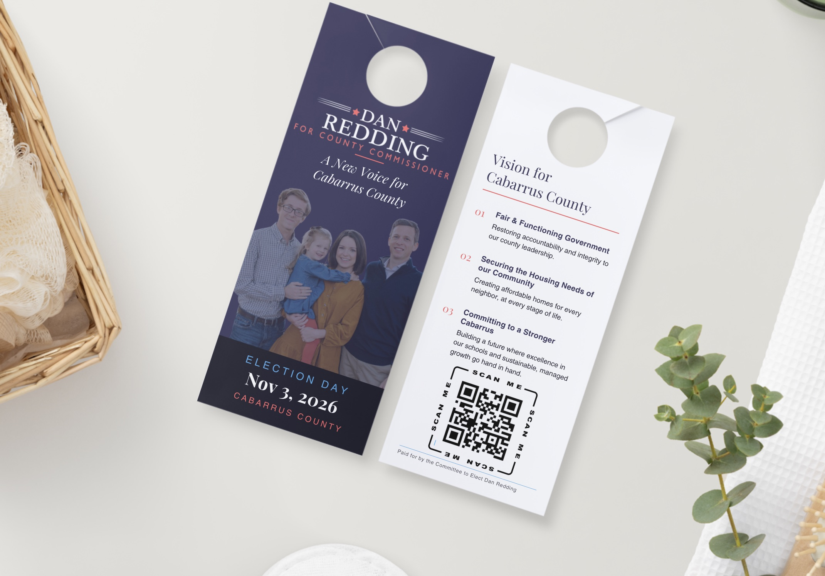
CASE STUDY · POLITICAL FIELD CREATIVE
Dan Redding for County Commissioner
Door-hanger canvassing collateral for a Cabarrus County, North Carolina race. The front does one job: name, office, and election day, legible from the walkway. The back carries three numbered positions and a QR code, so the voter who turns it over is already the voter worth converting.
DOOR HANGERS · CANVASS KIT · PRINT PRODUCTION
Notes:
Door hangers for a county commissioner race. Front carries the name and the date; back carries three positions and a QR. Field creative has to survive being read in four seconds on a porch.

Slide 29
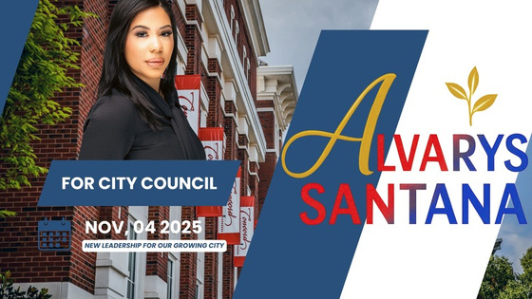
CASE STUDY · CANDIDATE IDENTITY
Candidate for City Council
A candidate identity built on a diagonal split: the district on one side, the name on the other. The palette holds the required red, white, and blue without reading as generic, and the sprout element ties it to the civic work.
ELECTION
November 4, 2025
LINE
New leadership for our growing city
DELIVERABLES
Banner, social kit, palm card, yard sign
Notes:
Alvarys ran for city council herself. The creative here is first-person: she has been the candidate, so she knows what a candidate needs on a two-week turnaround.

Slide 30
VIDEO AND EXPERIENTIAL
Moving image and physical experience
Powerful PSAs
Campaign concepts
Social reels
Mobile experience
Public service announcements built to evoke emotion and drive public awareness effectively.
Innovative campaign ads that resonate deeply with the audiences they are made for.
Short-form social video that captures attention and encourages community interaction online.
Car wrap designs, matching flyers, and VIP swag for a helicopter company's roadshow programme.
Notes:
Video storytelling and experiential. The helicopter roadshow is the outlier that proves the range.

Slide 31
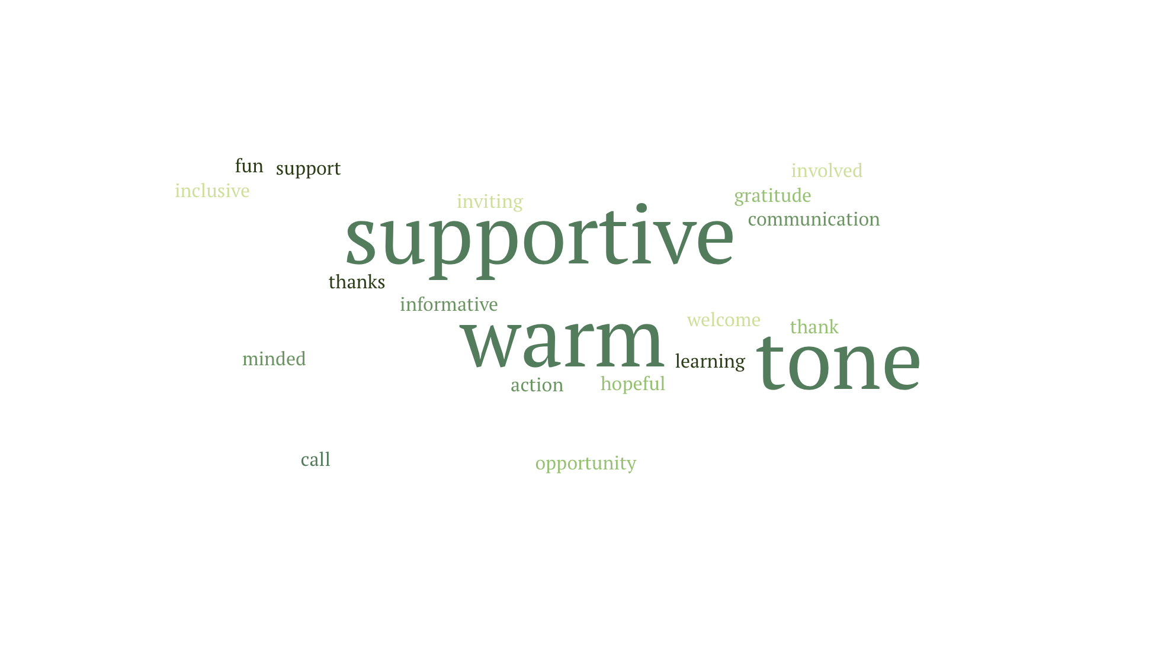
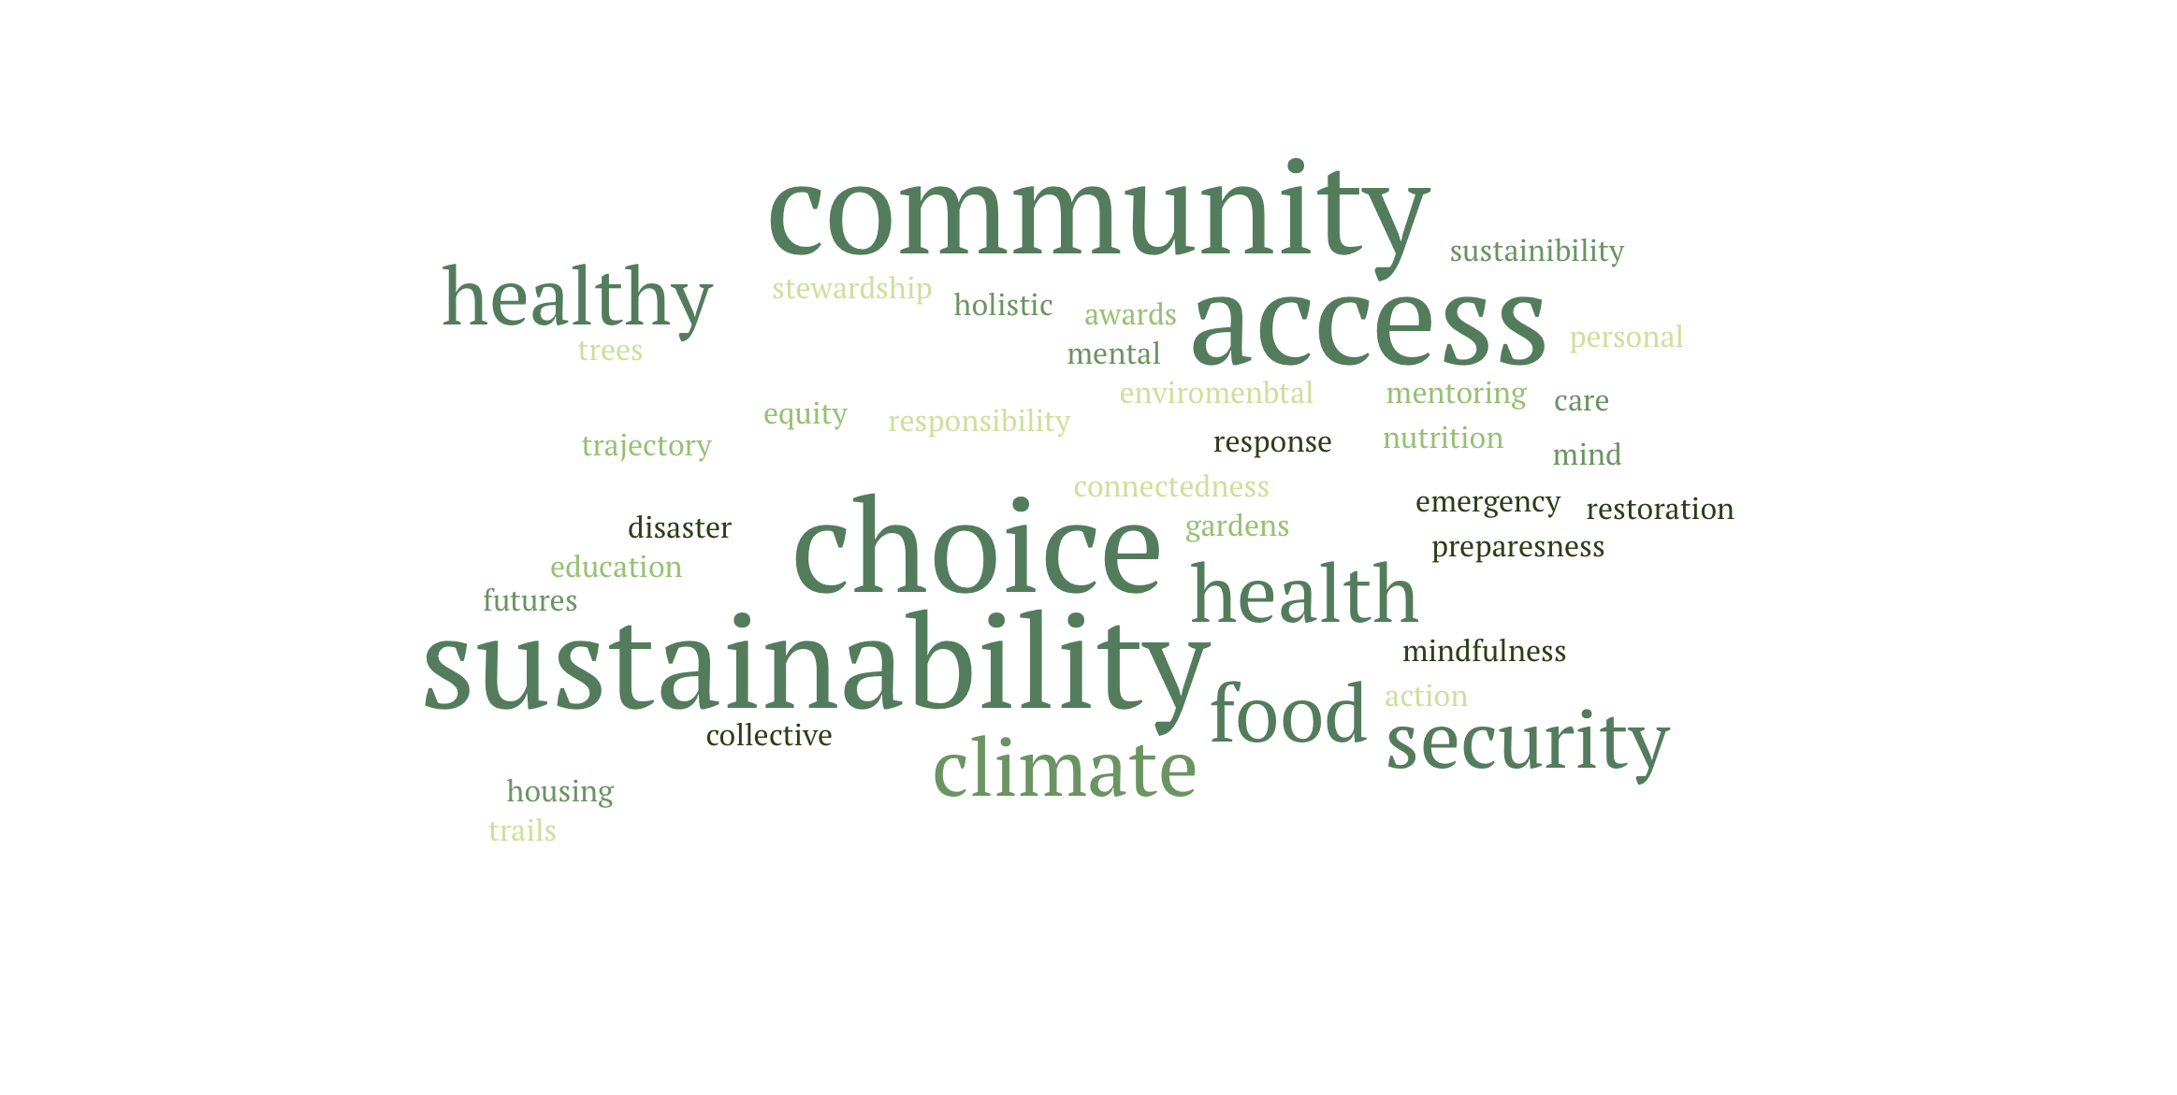
LIVE OUTPUT · TONE DETERMINATION
Stakeholders write the words they want people to feel. The cloud that comes back is the tone spec every piece of copy is then written against.
We show a room what it just said
Tone exercise
Priorities exercise
Warm, supportive, inviting. The result set the voice for every California Service Corps asset.
Sustainability, choice, community, access. Four words that ordered the entire programme calendar.
Notes:
Two live outputs from the same exercise. We ask a room to write the words they want people to feel, then show them what they actually said. The cloud is not decoration; it is the tone spec the copy is written against.

Slide 32
CLIENTS · LIVE
Look the work up
Campaign sites and client organizations, live at time of publication.
PinkSTEM
Just Plain Killers
California Volunteers
Youth fentanyl prevention
Campaign landing site
California Service Corps
pinkstem.org →
justplainkillers.com →
californiavolunteers.ca.gov →
Tropicana Community Services
AS STRATEGY™
Alvarys Santana
ARISE strategic framework
Strategy. Research. Results.
Principal
tropicanacommunity.org →
as-strategy.com →
linkedin.com/in/alvarys →
Additional client sites available on request. Several engagements are covered by confidentiality agreements.
Notes:
The roster with live links. Click any of these in the PDF version. Sector and geography are on the previous roster slide; this one is for looking the work up.

Slide 33
™
LET'S BUILD THE NEXT ONE
Strategy. Research. Results.
Alvarys Santana, MBA
alvaryssc@as-strategy.com
Charlotte, North Carolina
President & Principal Consultant
contracting@as-strategy.com
www.as-strategy.com
(704) 200-3171
UEI M1LQM4B4QMQ9 · CAGE 9LQ87
CERTIFIED WOSB · WBENC · DBE · NC SBE
Notes:
Close. Certifications matter for gov con audiences; leave the card on screen.

